Slide 1
Programming Bootcamp
Introduction
Project

Slide 2

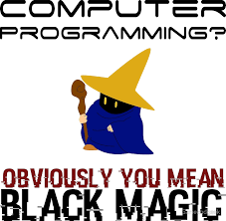
What is Programming?
Programming is magic:
Programming is ...
Programming is magic
The art and science of translating a set of ideas
into a program
Asking a computer to follow a list of instructions
Getting a computer to do what it is told
Writing code

Slide 3
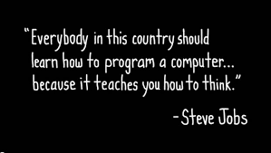
Why is Programming important?
Learning how to program is powerful:
Coding changes the world
Everybody should program
Software can achieve the impossible
Indistinguishable from magic
Businesses are built off of software
It is the critical skill of the future

Slide 4
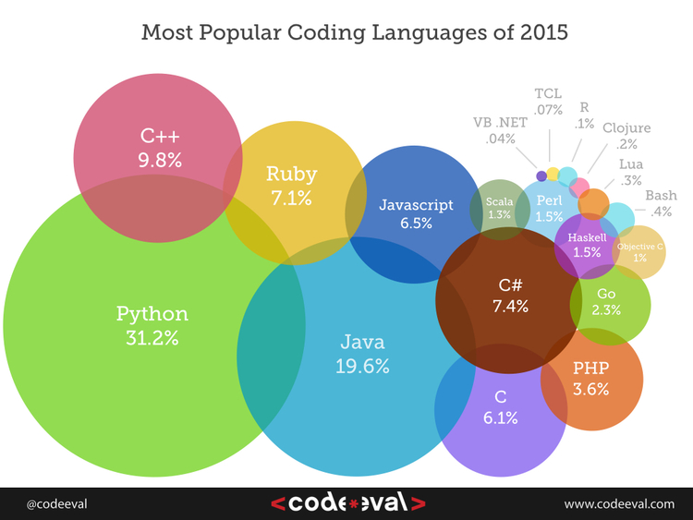
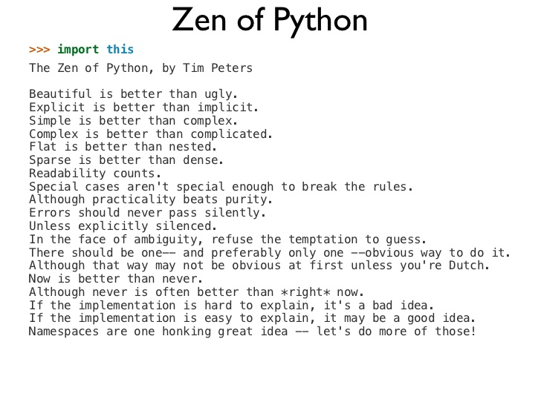
You will be learning Python!
Python is a great language to learn:
Many languages
Only One Python
Python is great!
Easy to use
Easy to learn
Great for Data Science
Simple, intuitive expressions
Large community
Open source
Easy to use
Easy to learn
Great for Data Science
Simple, intuitive expressions
Large community
Open source

Slide 5
What will you be doing over the next two weeks?
Learning
Assessment
Resources
Tutorials
Tests
Project
General background
reading
Learning specific skills
Testing the skills you have learnt
Move into a real-world
data science job!
13
6
1
1

Slide 6
What will you be learning over the next two weeks?
Overview
Concepts
Introduction to Programming
Basic concepts
What is Programming
Pseudo Code
Debugging Concepts
Installing Jupyter
Interactive vs Scripting mode
Your first program
1
Variables, Expressions and Statements
Basic syntax
Print Statement
Working with Variables
Working with Strings, Integers and floating points
Math functions
Relational operators
Importing modules
2
Truth, Conditionals and Iterative Processing
Working with Logic
True - False
If Statements
If else Statements
For Statements
While Statements
break | continue
Recursion
3
Functions
Building functions
How functions work
Creating functions
Working with functions
Parameters
Working with variables
Local and global variables
4

Slide 7
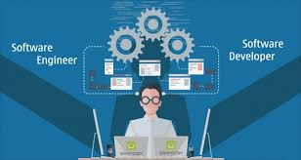



Your Project | Software Developer at ZunoTech
Problem Statement: Can we build a financial calculator?
Your Context
Your role
You are a Software Developer at ZunoTech
ZunoTech is a FinTech start-up that is 6 months old
ZunoTech’s plan is to build software for Financial Advisors
Project a customer’s Retirement Savings in the future
Help customer’s understand how big a homeloan they can take
Model a new financial product on the market
Stuff you need to Know
Your Job
Future and Present Value concepts
Future Value formula
Present Value formula
Write 7 Functions before the end of the week

Slide 8
Your Project | Build software for Financial Advisors
You specifically need to build 3 modules:
Difficulty
What are you building?
What do you need to do?
Project Retirement Savings
Easy
Build software that takes in key assumptions (investment returns, investment period and monthly investment) to project Retirement Savings
Write and Submit 3 Functions of increasing difficulty
1
Homeloan Affordability Caclulator
Medium
Build software that takes in key assumptions (monthly payment, finance rates, length of homeloan)) to show the maximum home-loan a customer can access
Write and Submit 3 Functions of increasing difficulty
2
Project Retirement Savings
Medium
Build software that takes in key assumptions (like investment returns, investment period and monthly investment) to project Retirement Savings of a new financial instrument
Write and Submit 1 Function
3

Slide 9
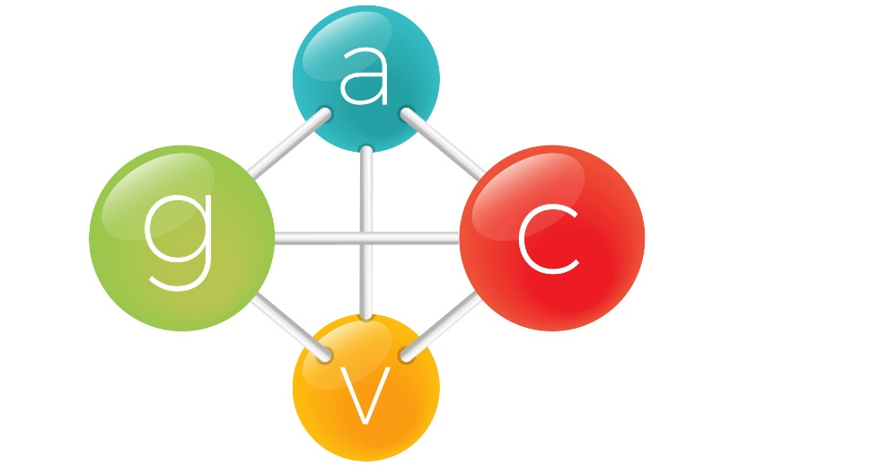
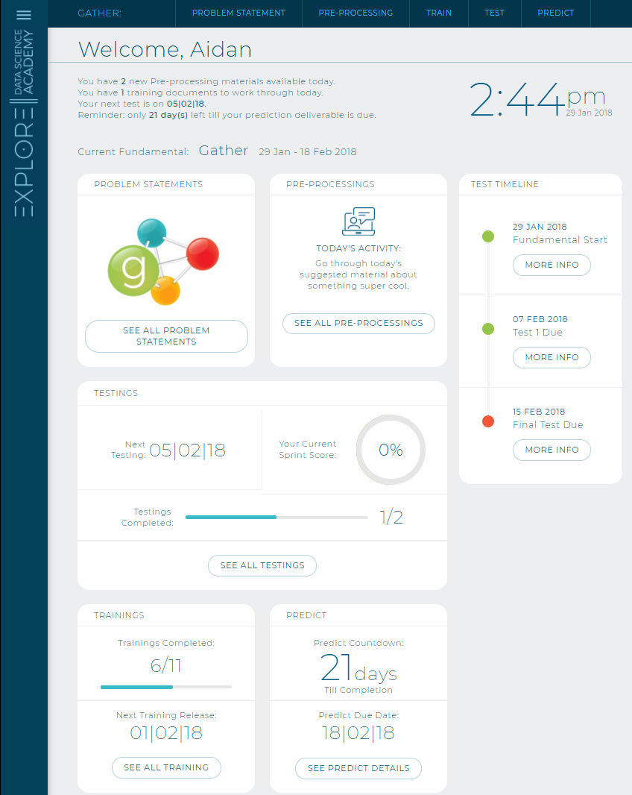

Logging into EDSA Platform - ATHENA
ATHENA is the ancient Greek goddess of wisdom, handicraft, and war

Slide 10
Welcome to the Explore Data Science Platform
Section | Description
Problem Statement | Presentation introducing a sprint Covers sprint theme, technical concepts & deliverables
Pre-processing | Links to the best technical materials available Textbook library for going deep…
Train | Practical application of key technical concepts Requires some “doing” - could be some code, or writing an essay or a group discussion
Test | Just a quick check that you are on the right track This will be a graded assessment of your understanding of the key concepts
Predict | Solving a real-world problem! Usually done in teams, these tasks are about applying your brand new data science skills!

